Slide 1
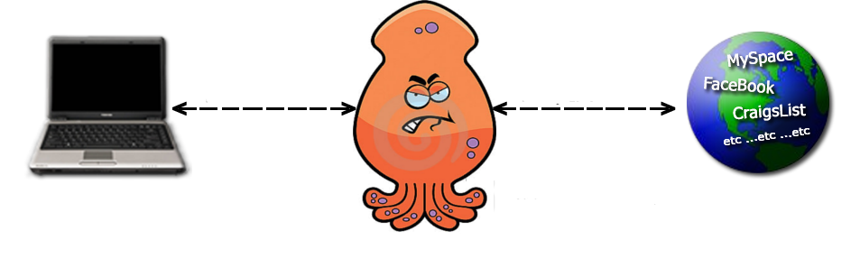
Squid Proxy Server
James Small
Garret Cuillier
David Kagawa-Aguirre

Slide 2
What is a Proxy Server?
A proxy server is a server that acts as an intermediary for requests from clients to other servers.
A client connects to a proxy server with a request for information from an outside source( web pages, files, etc..)
The proxy server evaluates the request according to its filtering rules (i.e. IP addresses or protocol)
Once the request is validated by the server filter, the proxy server provides the requested resource by connecting to the relevant server.

Slide 3

Squid Proxy Server
Web Cache proxy for HTTP/HTTPS/FTP.
A web cache temporary stores frequently-requested web pages (HTML pages, images) to reduce bandwidth usage, server load, and obvious lag.
Released under the General Public License
Free software

Slide 4


Why Use A Proxy Server?
1 in 33 workers only used Facebook at work.
77% of workers who have a Facebook account use it during work hours.

Slide 5
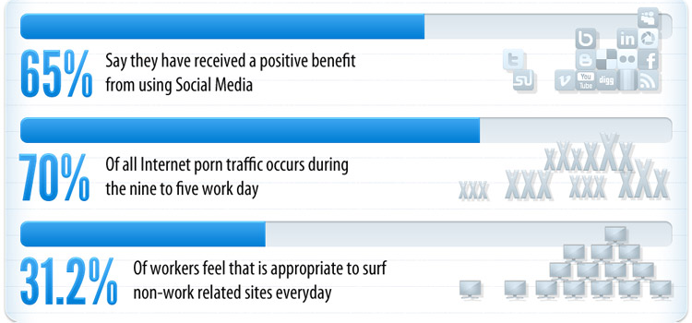
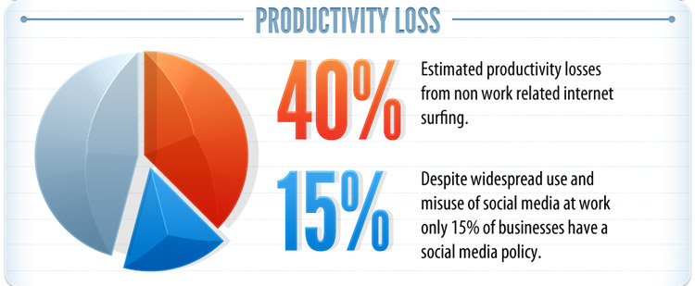
Why Use A Proxy Server?

Slide 6
Why Use A Proxy Server?
60% of online purchases are made during regular work hours.
65% of YouTube viewers watch between 9:00 and 17:00 on weekdays when (presumably) at work.
Fantasy football cost employers $10.5 billion in lost productivity.
18 Hours a week surfing the Internet during work hours is equivalent to $759 billion total salary cost for employers. That is $50 billion more than the entire 2011 US defense budget

Slide 7

Squid –Anonymous Proxy
Anonymous Proxy Server hides your IP address.

Slide 8
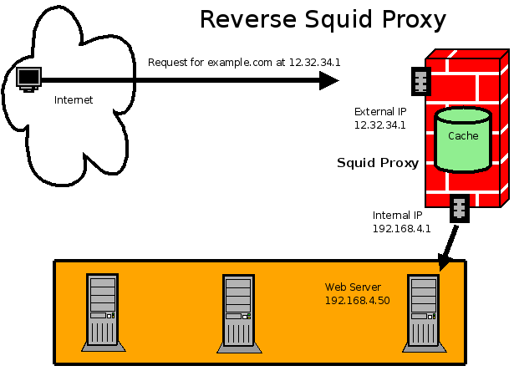
Reverse Proxy Cache

Slide 9
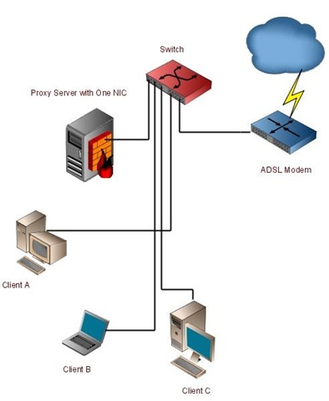
Transparent Proxy

Slide 10
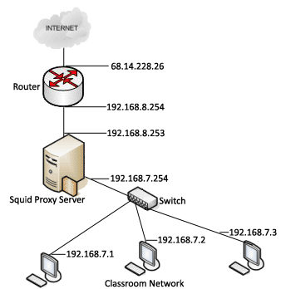
Squid Web Access Control

Slide 11
Squid Installation
yum –y install squid
add entry in iptables to open up port 3128 in firewall
edit /etc/sysconfig/iptables file
add: -A RH-Firewall-1-INPUT -m state –state NEW,ESTABLISHED,RELATED -m tcp -p tcp --dport 3128 -j ACCEPT
service iptables restart
Backup and create new squid.conf file
a. File is way too big
b. Make backup of squid.conf
i. cp squid.conf squid.conf.backup
c. Remove original
i. rm squid.conf
d. grep -v "^#" /etc/squid/squid.conf.backup | sed -e '/^$/d' > /etc/squid/squid.conf
4. Make necessary changes to file, see next page
5. Create denied_sites.txt
6. Create allowed_users.txt
7. chkconfig squid on
8. service squid start

Slide 12
Squid.conf File
http_port 3128
acl allowed_users src "/etc/squid/allowed_users.txt"
acl denied_sites dstdomain '/etc/squid/denied_sites.txt'
acl all src 0.0.0.0/0.0.0.0
acl manager proto cache_object
acl localhost src 127.0.0.1/255.255.255.255
acl to_localhost dst 127.0.0.0/8
acl SSL_ports port 443
acl Safe_ports port 80 # http
acl Safe_ports port 21 # ftp
acl Safe_ports port 443 # https
acl Safe_ports port 70 # gopher
acl Safe_ports port 210 # wais
acl Safe_ports port 1025-65535 # unregistered ports
acl Safe_ports port 280 # http-mgmt
acl Safe_ports port 488 # gss-http
acl Safe_ports port 591 # filemake
acl Safe_ports port 777 # multiling http
acl CONNECT method CONNECT
http_access allow manager localhost
http_access deny manager
http_access deny !Safe_ports
http_access deny CONNECT !SSL_ports
http_access allow localhost
http_access allow allowed_users
http_access deny denied_sites
http_access allow all
icp_access allow all
logformat combined [%tl] %>A %{Host}>h "%rm %ru HTTP/%rv" %Hs %<st "%{Referer}>h" "%{User-Agent}>h" %Ss:%Sh
access_log /var/log/squid/access.log combined

Slide 13
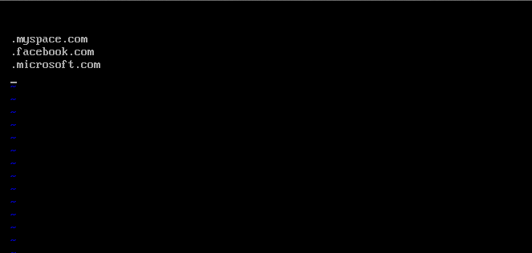
denied_sites.txt

Slide 14
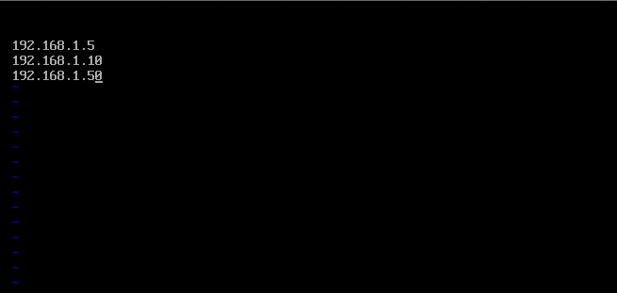
allowed_users.txt

Slide 15
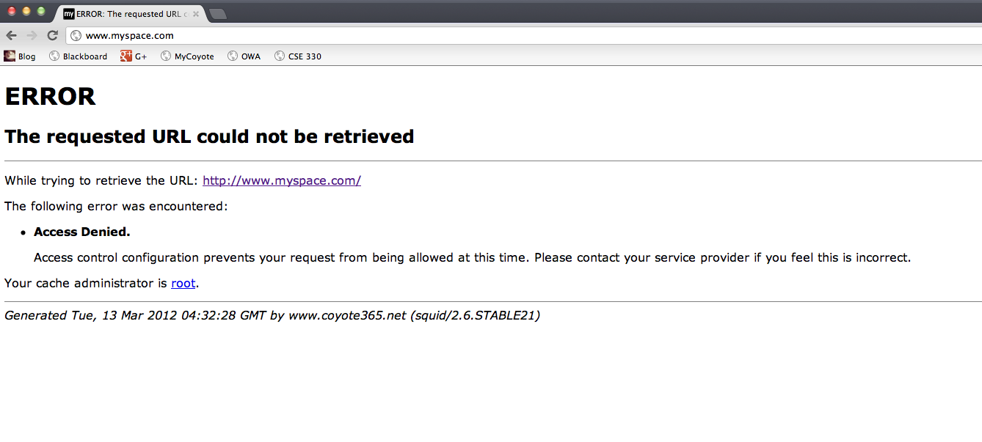
Squid Proxy Blocked URL

Slide 16
Works Cited
Social Media: “The Next Great Gateway for Content Discovery?” Posted By Jon Gibs, VP Media Analytics for Nielsen.com (Oct. 5, 2009)
Stop Wasting Time on Social Media - Anthony Kirlew (Oct. 12, 2011)

